Slide 1
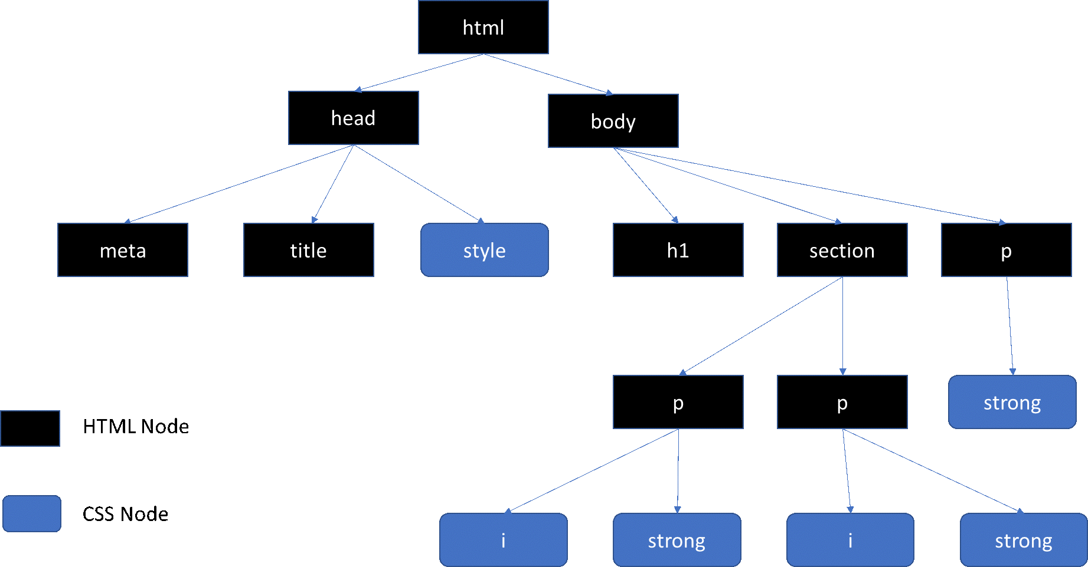
DOM Manipulation in JavaScript

Slide 2
WHAT IS THE DOM?
The DOM defines a standard for accessing documents. It represents the page so that programs can change the document structure, style, and content.

Slide 3
WHAT WE WILL COVER:
Creating elements
Creating an element in the DOM using Javascript
Selecting elements
Selecting already existing elements in the DOM using Javascript
Setting attributes
Setting attributes of elements in the DOM
Bonus: Quiz

Slide 4
Creating a new element
In Javascript | In HTML
Document.createElement('div') | <div></div>

Slide 5
Creating a new element
In Javascript | In HTML
document.createElement('div') | <div></div>
document.createElement('p') | <p></p>

Slide 6
Your turn: How do you think we would create a form element in the dom?
In Javascript | In HTML
document.createElement('div') | <div></div>
document.createElement('p') | <p></p>
????? | <form></form>

Slide 7
Your turn: How do you think we would create a form element in the dom?
In Javascript | In HTML
document.createElement('div') | <div></div>
document.createElement('p') | <p></p>
document.createElement('form') | <form></form>

Slide 8
We can also give elements in the DOM a class name in Javascript
If an element is created in Javascript:
const form = document.createElement('form')
If an element already exists in the DOM (from html) and is being selected in Javascript:
const form= document.querySelector('.form')
form.className= "hello"
<form class="hello></form>

Slide 9
Selecting an existing element from the DOM
HTML
<div id="container" class="card"></div>
JAVASCRIPT
Selecting by ID | Selecting by Class
document.querySelector('#container') | document.querySelector('.card')

Slide 10
Your turn: How would we select the p tag below in Javascript?
HTML
<p id="lorem" class="paragraph" ></p>
JAVASCRIPT
Selecting by ID | Selecting by Class

Slide 11
Your turn: How would we select the p tag below in Javascript?
HTML
<p id="lorem" class="paragraph"></p>
JAVASCRIPT
Selecting by ID | Selecting by Class
document.querySelector('#lorem')

Slide 12
Your turn: How would we select the p tag below in Javascript?
HTML
<p id="lorem" class="paragraph"></p>
JAVASCRIPT
Selecting by ID | Selecting by Class
document.querySelector('#lorem') | document.querySelector('.paragraph')

Slide 13
What if we had several elements in the dom with the same class or ID?
document.querySelectorAll('.paragraph')
This will select all elements with the class of paragraph!

Slide 14
Setting an attribute
const b = document.querySelector("button"); b.setAttribute("name", "helloButton");
In Javascript | In HTML
const img = document.querySelector('img') img.setAttribute=("src", "https://www.google.com") | <img>

Slide 15
How do we create a h1 element in Javascript? (I.e. <h1></h1>)
document.querySelector('h1')
1
document.createElement('h1')
2
document.querySelectorAll('.h1')
3

Slide 16
How do we select an existing div element with a class of "container" in Javascript? (I.e. <div class="container></div>
document.querySelector('.container')
1
document.createElement('#container')
2
document.querySelector('#container')
3

Slide 17
How do give an input element a type of "text an input element in Javascript? (I.e. <input type="text" class="field">)
const input = document.querySelector(".field"); input.setAttribute("type", "text");

